Slide 1
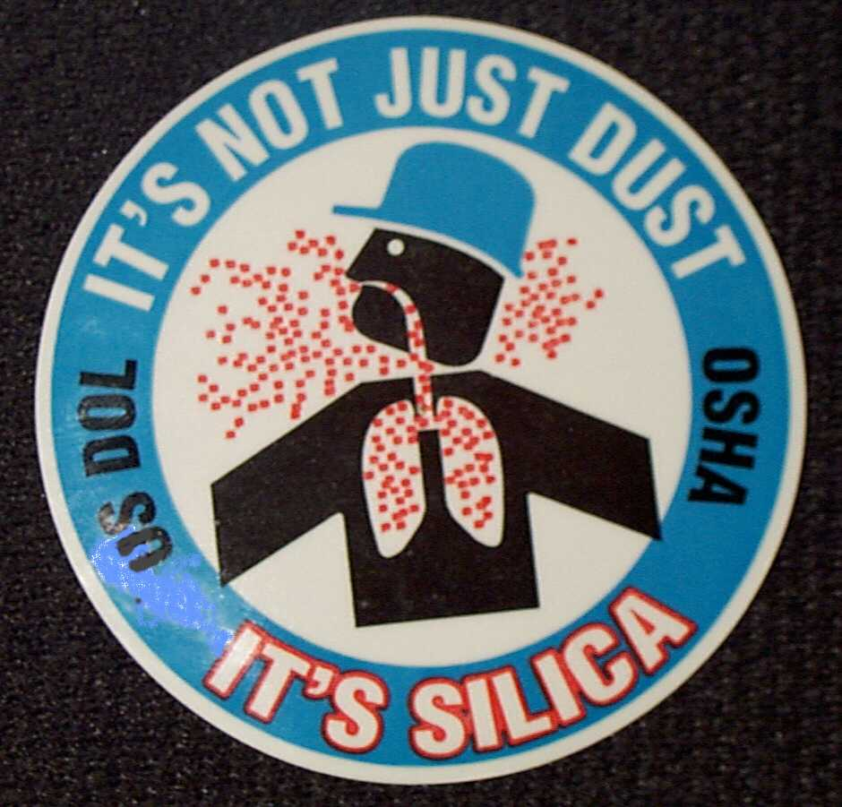
Silica – it’s more than just dust!
Alaska Occupational Safety & Health (AKOSH)

Slide 2
Purpose of this training
Overall the purpose of this training is to provide you with information about the serious health hazards of silica dust. In addition to general information, this training will also discuss…
The 29 CFR 1910.1200 hazard communication regulations.
Work processes that are at high risk to exposure.
Proposed changes to the OSHA permissible exposure levels.
1
Notes:
Note: this slide can be deleted for your presentation.

Slide 3
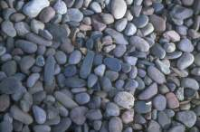
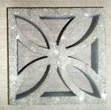
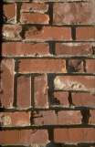
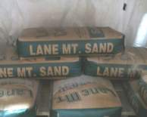
What is Silica?
Silica is Quartz
Quartz (silica) is found naturally in almost all rock, sand and soil.
It is also found in concrete products and bricks.
It is sometimes found in sandblasting (abrasive blasting) grit and is called “silica sand”.
4
Notes:
“Silica dust is generated from cutting, grinding, drilling, sanding sandblasting, or abrasive blasting, on concrete, bricks or masonry blocks. A common brand name silica sand used for abrasive blasting in this area is Lane Mountain. If the blasting grit contains silica, it will usually be labeled as silica sand or as containing quartz, or crystalline silica.”

Slide 4
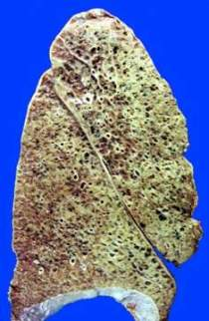
Silica Health Hazards
Inhaled silica dust scars the lungs
A lung disease called “silicosis” is caused by breathing of dust containing silica.
The dust causes “fibrosis” or scar tissue formation in the lungs.
This reduces the lung’s ability to extract oxygen from the air.
There is no cure.
5
Notes:
“Because the effects of silica is irreversible, it is considered to be a serious health hazard on many construction sites.”

Slide 5
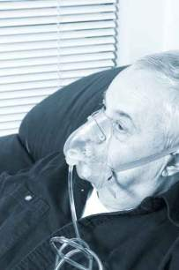
Silica Health Hazards
Other Health Effects
Susceptibility to other lung diseases and infections such as tuberculosis.
Acute silicosis may develop after very short periods of high exposure.
Chronic silicosis develops after many years of lower levels of exposure.
7
Notes:
“Chronic silicosis is the more common health effect. Acute silicosis occurs after exposure to massive amounts of silica dust. Although rare, workers in their 30’s and 40’s who didn’t know they were working with silica and didn’t wear respirators at all, actually died by suffocation within months of exposure to extremely heavy silica dust concentrations. Their lungs were so badly scarred they could no longer get enough oxygen.”

Slide 6
Permissible Exposure Limits
 |  | Current Federal OSHA 1910 Exposure Limits |  | Current Federal OSHA 1915 Exposure Limits |  | Current Federal OSHA 1926 Exposure Limits
 |  | 8-HR TWA |  | 8-HR TWA |  | 8-HR TWA
 |  | mppcf | mg/m³ | mppcf |  | mppcf
 |  | Formula Calculation: (X / (%SiO₂+5) | Formula Calculation: (X mg/m³) / (%SiO₂) | Formula Calculation: (X / (%SiO2+5) |  | Formula Calculation: (X / (%SiO2+5)
Silica, Crystalline Quartz (Respirable) | Formula Calculation: (X mg/m³) / (%SiO₂) | 250 | 10 | 250 |  | 250
Silica, Crystalline Quartz (Total Dust) | Cristobalite: Use 1/2 the value calculated from the count or mass formulae for quartz. Tridymite: Use 1/2 the value calculated from the formulae for quartz. |  | 30
Amorphous, including natrual diatomaceous earth |  |  | 80 | 20 |  | 20
 |  | Updated Permissible Exposure Limits For OSHA 1910, 1915, 1926 Combined
 |  |  |  | 8 -HR TWA
 |  |  |  | µg / m³
Silica, Crystalline Quartz (Respirable) |  |  |  | 50

Slide 7
Clear Comparison
Current OSHA 1910 PEL equal to 100 µg/m³
Current OSHA 1915, and 1936 PEL equal to 250 µg/m³
New PEL’s will be 50 µg/m³ across all three industries
Action level will need to occur at 25 µg/m³
More or less, if there is visible dust there will need to be monitoring performed.

Slide 8
Silica Exposure in Construction
Silica is found in many construction jobs
Abrasive blasting (sand blasting)
Rock drilling
Concrete & masonry building construction
Earthwork and rock crushing
Masonry or concrete building demolition
Road construction and repair
9
Notes:
“These are typical construction jobs where silica dust is usually found.”

Slide 9
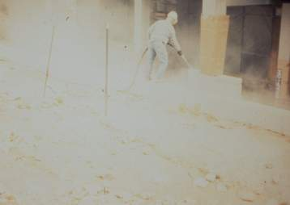
Silica Exposure - Sandblasting
Sandblasting with silica sand creates extremely high levels of silica dust.
Sandblasting on concrete with any kind of grit produces high levels of silica dust.
Sandblasting always requires the use of a respirator.
He needs an abrasive blasting respirator!
10
Notes:
“Sandblasting concrete even without silica sand still results in high levels of silica in the air from the concrete itself.”

Slide 10
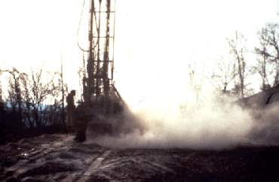
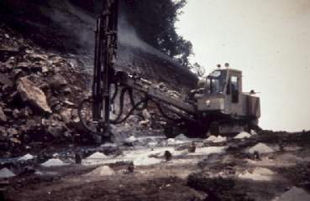
Silica Exposure – Rock Drilling
Rock drilling without water produces large amounts of dust.
Drilling without water
Your actual exposure will depend on the wind, where you stand and if you use water to control the dust.
Drilling with water
11
Notes:
“ Use of water during rock drilling may lower the levels of silica in the air below the PEL.”

Slide 11
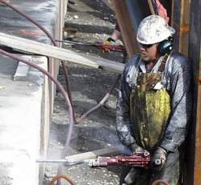
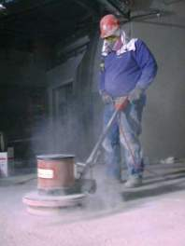
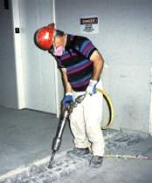
Silica Exposure in Construction
Concrete Work
Power sanding
Jack-hammering
Generates moderate to heavy amounts of dust
Generates heavy amounts of dust
12
Notes:
“Using water will usually reduce levels to below the PEL in these activities. “

Slide 12
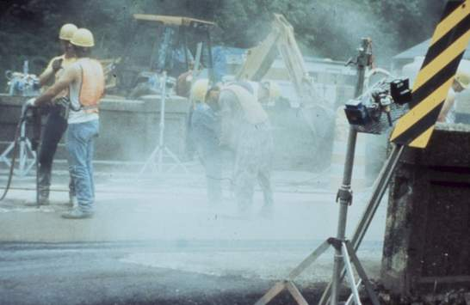
Silica Exposure –Concrete Highway work
Drilling concrete pavement dry
Generates moderate amounts of dust
13
Notes:
“Drilling outdoors may result in lower dust exposure to drillers because the work is sporadic and wind may blow the dust away from their breathing zone. But the exposure limit for silica can still be easily exceeded if workers are downwind or in the dust cloud.”

Slide 13
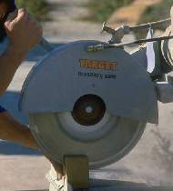
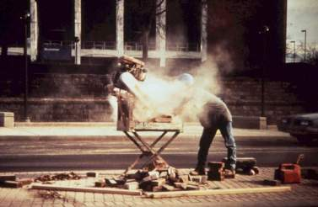
Silica Exposure – brick and cinder block cutting
Without water
With water
Generates moderate to heavy amounts of dust without water.
15
Notes:
“Masonry Saws, requires that water or exhaust ventilation always be used on masonry saws.” Note the water hose on top of the drill on the right photo.”

Slide 14
The Risk of Silica Exposure
When dust is controlled, exposures are low.
When dust is uncontrolled, exposures are high.
Many exposures are for short time periods, but at very high concentrations.
Short, high exposure can still exceed permissible limits and cause lung damage.
19
Notes:
“ In many construction jobs, we have short but high exposures to silica. But every time you inhale silica dust, it is like inhaling fine, broken glass which scar your lungs. It adds up over time.”

Slide 15
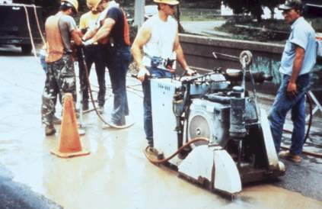
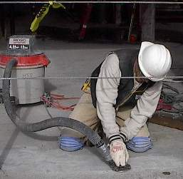
Silica dust exposure can be controlled by use of water or exhaust ventilation
Using water to cut concrete and bricks
Concrete sander with exhaust ventilation
20
Notes:
“ Using water for dust suppression is usually the most effective way of controlling silica dust. If inadequate amounts of water are used, operators of concrete cutters can still be exposed to too much silica dust. The amount often suggested is a pint of water per minute for best dust control. Too much water can create a disposal or cleanup problem and sometimes soak the operator.
The vacuum must have HEPA (high efficiency) filters to completely capture the fine dust.”

Slide 16
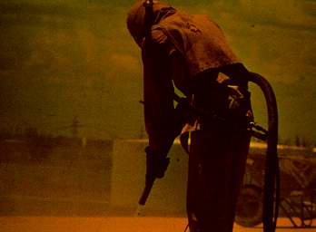
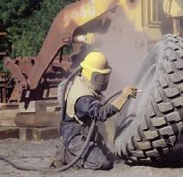
Silica Exposure Control - Sandblasting
The best control is to not use silica sand.
Substitutes include garnet, glass beads, aluminum oxide, or iron oxide.
If silica sand is used, keep other workers away from area.
If workers must be in the area, they will need to wear respirators too.
21
Notes:
“New sandblasting equipment using water has been recently developed, but the levels of silica in the air will probably still exceed the allowable limit. Acid washing is sometimes used to prepare concrete flooring , rather than sandblasting.”

Slide 17
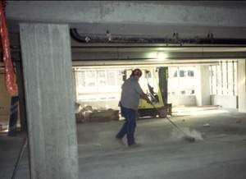
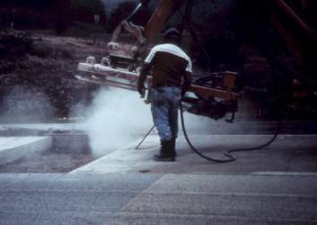
Silica Exposure Control
Avoid dry sweeping and use of compressed air on concrete
Both these activities can stir up large amounts of dust. Use a vacuum with high efficiency filters when possible.
22
Notes:
“When these activities cannot be avoided, respirators must be worn.”

Slide 18
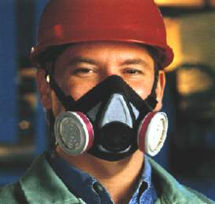
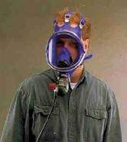
Silica and Use of Respirators
Respirators must be used if silica dust can’t be controlled with water or ventilation
either
or
Air-purifying respirator with dust cartridge
Supplied air respirator
24
Notes:
“One-piece dust masks can also be used, but are not recommended because they don’t always fit properly and can leak with prolonged use. Respirators may still be needed even when steps have been taken to reduce the amount of dust in the air. Sometimes, it can be difficult to reduce the amount of silica dust to levels below the permissible limits. A supplied air respirator may be needed for high levels of silica dust where water or ventilation can’t be used to control the dust. A supplied air respirator is required if the amount of silica in the air is more than 10 times the permissible limit”

Slide 19
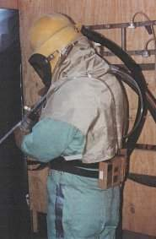
Sandblasting Respirators
(Abrasive blasting hoods)
Sandblasting with silica sand requires a full sandblasting hood.
The sandblaster helper will also need a respirator. Nearby employees may need respirators, also.
25
Notes:
“ Sandblasting respirators are ALWAYS required when sandblasting with silica sand. Sandblasting on concrete or bridges with lead paint also require sandblasting hoods.”

Slide 20
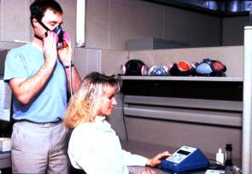
Respirators Must Fit Properly
Respirators must fit properly to prevent leaks around the edges.
Fit-testing must be done before first wearing a respirator.
Beards are not allowed when wearing a respirator.
28
Notes:
“You can’t get a proper fit with a beard – the respirator will leak. The only exception to the no-beard rule is when a sandblasting hood is used, since it covers the whole head.”

Slide 21
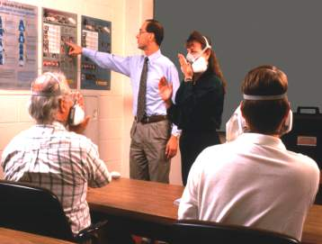
Employees using respirators must be trained
Training is required by DOSH for anyone who wears a respirator.
If you don’t know how to use a respirator properly, you may think your respirator is providing protection when it is not.
27
Notes:
“ We will do respirator training for all of our employees who are required to wear respirators.”

Slide 22
Need More Information?
Seth Wilson
AKOSH Consultation
(907) 451-2888
www.osha.gov
Or the proposed changes in the federal register at:
https://www.federalregister.gov/articles/2013/09/12/2013-20997/occupational-exposure-to-respirable-crystalline-silica

